Slide 1
Statistics for linguists
2023-11-29
Linear models, ANOVA, Chi-squared test

Slide 2
From last week
P-values
Confidence intervals (see video on moodle)
Models in general
Linear models

Slide 3
Concepts you mentioned
Standard deviation and mean
Cross-tabulation with a chi-square test
Binomial test
Rank tests
Bivariate analysis
Multiple logistic regression analysis
Regression model
Inter-rater reliability
Cluster-based permutation test
One-tail test
bootstrapping
null distribution
surrogate distribution
baseline distribution
mixed-effect models
z-score

Slide 4
Concepts you mentioned
Standard deviation and mean
Cross-tabulation with a chi-square test
Binomial test
Rank tests
Bivariate analysis
Multiple logistic regression analysis
Regression model
Inter-rater reliability
Cluster-based permutation test
One-tail test
bootstrapping
null distribution
surrogate distribution
baseline distribution
mixed-effect models
z-score

Slide 5
Concepts you mentioned
Standard deviation and mean
Cross-tabulation with a chi-square test
Binomial test
Rank tests
Bivariate analysis
Multiple logistic regression analysis
Regression model
Inter-rater reliability
Cluster-based permutation test
One-tail test
bootstrapping
null distribution
surrogate distribution
baseline distribution
mixed-effect models
z-score

Slide 6
For this week
Linear models (continued)
Analysis of variance
Chi-squared test

Slide 7
For this week
Packages to load
library(tidyverse)
library(lattice) library(Rling) library(languageR) library(nhstplot) library(reshape)
elp.df <- read.csv(“YourPath/ELP_full_length_frequency.csv") senses <- read.csv(“YourPath/winter_2016_senses_valence.csv") data(ldt) data(sharedref)

Slide 8
Analysis of Variance
What is typically referred to as ANOVA (Analysis of variance) often refers to a type of linear model, where all the predictors are categorical.
Here’s a way to visualize the difference:
In a regression (linear model), you add a line that has an intercept and a slope
In an ANOVA (linear model), you add more than one horizontal line with separate intercepts but 0 slope each

Slide 9
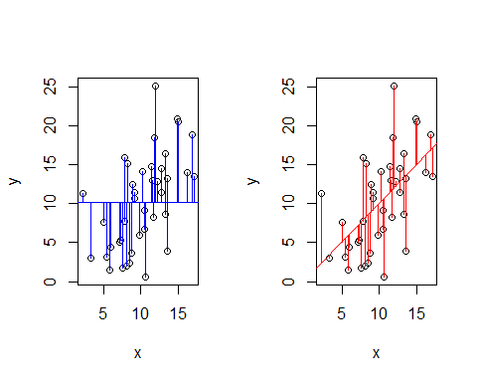
Crawley, Michael J. 2015. Statistics: An Introduction using R. Wiley.

Slide 10
Regression model
Null model: For Response latencies – you can develop a ‘model’ of response latencies based only on response latencies – it just says “assume the mean”
Regression model: Or you can develop a model of response latencies based on the length of words – this model says “assume a response latency i for a given length of word j according to the following line”
Your statistics are asking which one is better

Slide 11
Null model – just add a horizontal line through y datapoints
corresponds to the mean of y and makes no reference to x
Regression model (linear model): add a line that corresponds to y changing as x changes: x informs y
Crawley, Michael J. 2015. Statistics: An Introduction using R. Wiley.

Slide 12
How do I test whether a y-variable only line (null) is better than an x predicts y linear model?
Add up all the residuals (distances from the means) and see if there is a big enough difference given your sample size.
Crawley, Michael J. 2015. Statistics: An Introduction using R. Wiley.

Slide 13

Linear model
$$y=a+βx$$
$$y=a+βx+ε$$
$$ε \sim N(0,σ)$$

Slide 14

Linear model
What makes a model a statistical model is that it has some stochastic component
In a classical linear model, this is the error term
The error term is supposed to follow a normal distribution with 0 mean
$$y=a+βx$$
Formula for a straight line
$$y=a+βx+ε$$
Error
Normally distributed
0 Mean
Standard deviation
$$ε \sim N(0,σ)$$

Slide 15
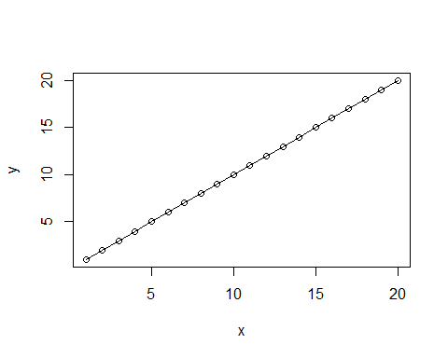
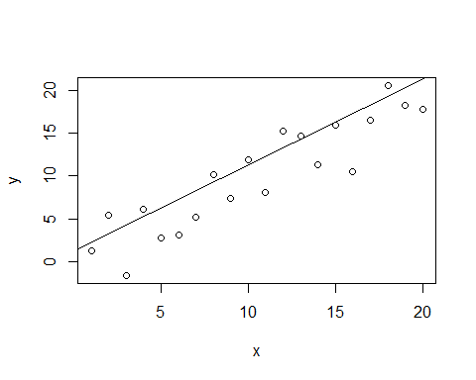

##Deductive model x <- seq(from=1, to=20) b <- 1 a <- 0 y <- a + b*x plot(y~x)+lines(y,x)
##Statistical model x <- seq(from=1, to=20) b <- 1 a <- 0 e <- rnorm(m=0,sd=3, n=20) y <- a + b*x + e plot(y~x)+abline(y,x)
$$ε \sim N(0,3)$$

Slide 16
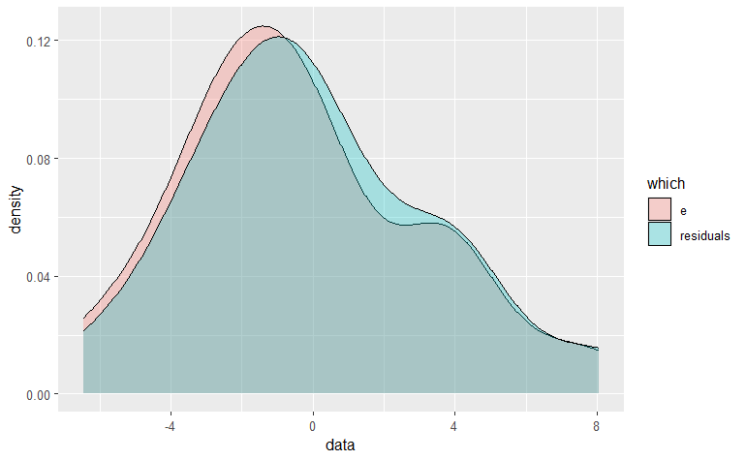
y_hat <- predict(lm(y~x)) residuals <- y - y_hat error_residuals <- make.groups(e, residuals) ggplot(error_residuals, aes(x=data, fill=which))+ geom_density(alpha=0.3)
$$d=y−\hat{y}$$
Our generated errors are almost the same as the residuals
Based on
Crawley, Michael J. 2015. Statistics: An Introduction using R. Wiley.

Slide 17
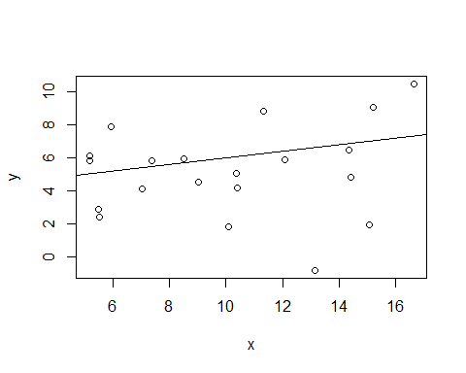
Linear models and inference
##Line through unrelated vectors x <- rnorm(20, 10, 4) y <- rnorm(20, 5, 3) plot(y~x)+abline(a=4, b=0.2)
How do I make inferences about my line?
Is my line explaining any of the variability?
Note: you can draw a line through two vectors that are unrelated to one another - this does not mean that they are related.
Based on
Crawley, Michael J. 2015. Statistics: An Introduction using R. Wiley.

Slide 18
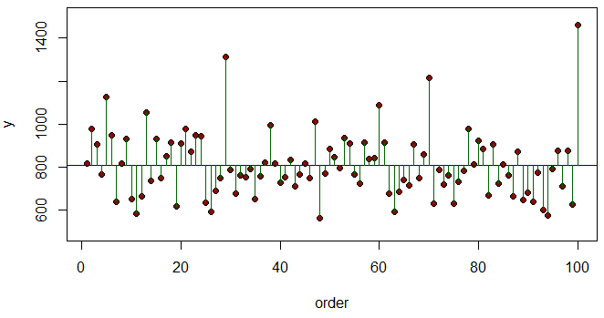
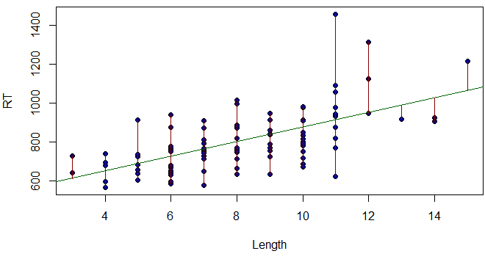
Linear models and inference
Compare the variance accounted for by just predicting the mean of y (23472)
... to the variance accounted for by varying y according to x in a linear model (1202)
vs.
Crawley, Michael J. 2015. Statistics: An Introduction using R. Wiley.

Slide 19
data(ldt) RT <- ldt$Mean_RT plot(1:100,RT,ylim=c(500,1500),ylab="y",xlab="order",pch=21,bg="darkred") abline(h=mean(RT),col="darkblue") for(i in 1:100) lines(c(i,i),c(mean(RT),RT[i]),col="darkgreen")
Length <- ldt$Length plot(Length,RT,pch=21,bg="darkblue") abline(lm(RT~Length),col="darkgreen") fitted <- predict(lm(RT~Length)) lines(c(0,0),c(12,11.755556))
for (i in 1:100)
lines (c(Length[i],Length[i]),c(RT[i],fitted[i]),col="darkred")
Based on
Crawley, Michael J. 2015. Statistics: An Introduction using R. Wiley.

Slide 20
model_1 <- lm(Mean_RT~Length, data=ldt) summary(model_1)
## ## Call: ## lm(formula = Mean_RT ~ Length, data = ldt) ## ## Residuals: ## Min 1Q Median 3Q Max ## -291.74 -77.81 -3.69 47.92 546.22 ## ## Coefficients: ## Estimate Std. Error t value Pr(>|t|) ## (Intercept) 498.443 41.949 11.882 < 2e-16 *** ## Length 37.644 4.879 7.716 1.02e-11 *** ## --- ## Signif. codes: 0 '***' 0.001 '**' 0.01 '*' 0.05 '.' 0.1 ' ' 1 ## ## Residual standard error: 121.5 on 98 degrees of freedom ## Multiple R-squared: 0.3779, Adjusted R-squared: 0.3716 ## F-statistic: 59.53 on 1 and 98 DF, p-value: 1.019e-11

Slide 21

model_1 <- lm(Mean_RT~Length, data=ldt) summary(model_1)
## ## Call: ## lm(formula = Mean_RT ~ Length, data = ldt) ## ## Residuals: ## Min 1Q Median 3Q Max ## -291.74 -77.81 -3.69 47.92 546.22 ## ## Coefficients: ## Estimate Std. Error t value Pr(>|t|) ## (Intercept) 498.443 41.949 11.882 < 2e-16 *** ## Length 37.644 4.879 7.716 1.02e-11 *** ## --- ## Signif. codes: 0 '***' 0.001 '**' 0.01 '*' 0.05 '.' 0.1 ' ' 1 ## ## Residual standard error: 121.5 on 98 degrees of freedom ## Multiple R-squared: 0.3779, Adjusted R-squared: 0.3716 ## F-statistic: 59.53 on 1 and 98 DF, p-value: 1.019e-11
$$y=a+βx+ε$$

Slide 22
model_1 <- lm(Mean_RT~Length, data=ldt) summary(model_1)
## ## Call: ## lm(formula = Mean_RT ~ Length, data = ldt) ## ## Residuals: ## Min 1Q Median 3Q Max ## -291.74 -77.81 -3.69 47.92 546.22 ## ## Coefficients: ## Estimate Std. Error t value Pr(>|t|) ## (Intercept) 498.443 41.949 11.882 < 2e-16 *** ## Length 37.644 4.879 7.716 1.02e-11 *** ## --- ## Signif. codes: 0 '***' 0.001 '**' 0.01 '*' 0.05 '.' 0.1 ' ' 1 ## ## Residual standard error: 121.5 on 98 degrees of freedom ## Multiple R-squared: 0.3779, Adjusted R-squared: 0.3716 ## F-statistic: 59.53 on 1 and 98 DF, p-value: 1.019e-11
‘R-squared’: How much variabililty the model explains
(0 = no variability, 1 = all the variability)

Slide 23
Exercise
Exercise:
Load the data(ELP_Frequency)
Winter 2019
Run lm() models with reaction time as dependent variable and once with frequency as predictor and once with length as a predictor.
Which predictor is better?
Winter, Bodo. 2019. Statistics for Linguists: An Introduction using R. Routledge.
https://osf.io/34mq9/

Slide 24
Analysis of Variance
ANOVA (Analysis of Variance) does the same type of calculation but its better to think (initially) in terms of multiple lines rather than one line with a slope and intercept.
Null model (H0): (same as for linear model) variance with all the data pooled
Alternative model (H1): total variance with all the data put into groups
Crawley, Michael J. 2015. Statistics: An Introduction using R. Wiley.

Slide 25
Analysis of Variance
Let’s look at the senses data from Winter (2016)
head(senses)
## Word Modality Val ## 1 abrasive Touch 5.398113 ## 2 absorbent Sight 5.876667 ## 3 aching Touch 5.233370 ## 4 acidic Taste 5.539592 ## 5 acrid Smell 5.173947 ## 6 adhesive Touch 5.240000
Winter, Bodo. 2016. Taste and smell words form an affectively loaded and emotionally flexible part of the English lexicon. Language, Cognition and Neuroscience http://dx.doi.org/10.1080/23273798.2016.1193619
https://osf.io/34mq9/

Slide 26
Analysis of Variance
Filter for Taste and Sound
This will simplify our analysis
senses_01 <- filter(senses, Modality =="Taste" | Modality =="Sound") modality <- senses_01$Modality Val <- senses_01$Val

Slide 27
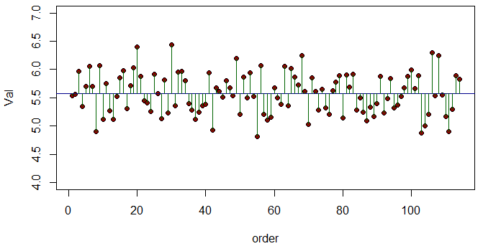
Analysis of Variance
This is how we visualize our null model of the valence metric
Winter, Bodo. 2016. Taste and smell words form an affectively loaded and emotionally flexible part of the English lexicon. Language, Cognition and Neuroscience http://dx.doi.org/10.1080/23273798.2016.1193619
https://osf.io/34mq9/
plot(1:114,Val,ylim=c(4,7),ylab="y",xlab="order",pch=21,bg="darkred") abline(h=mean(Val),col="darkblue") for(i in 1:114) lines(c(i,i),c(mean(Val),Val[i]),col="darkgreen")
Crawley, Michael J. 2015. Statistics: An Introduction using R. Wiley.

Slide 28
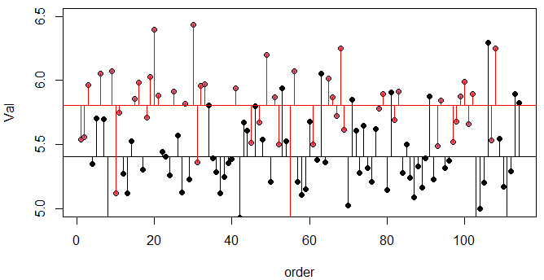
Analysis of Variance
Our alternative hypothesis is that the variance in VAL can be explained by splitting the data into two groups
Quiz:
If the means between the senses were not different, where wowuld the lines be?
Crawley, Michael J. 2015. Statistics: An Introduction using R. Wiley.

Slide 29
senses_01 <- filter(senses, Modality =="Taste" | Modality =="Sound") modality <- senses_01$Modality Val <- senses_01$Val plot(1:114,Val,ylim=c(5,6.5),ylab="Val",xlab="order", pch=21,bg= as.numeric(as.factor(modality))) #abline(h=mean(Val[modality=="Sight"]),col="darkgreen") #abline(h=mean(Val[modality=="Smell"]), col="darkred") abline(h=mean(Val[modality=="Sound"]), col="black") #abline(h=mean(Val[modality=="Taste"]), col="cornflowerblue") abline(h=mean(Val[modality=="Taste"]), col="red") index <- 1:length(Val) for (i in 1:length(index)){ if (modality[i] == "Sound") lines(c(index[i],index[i]),c(mean(Val[modality=="Sound"]),Val [i])) else lines(c(index[i],index[i]),c(mean(Val[modality=="Taste"]),Val [i]), col="red") }

Slide 30
Quiz:
If the mean difference is different, would the residual lines be larger or smaller than when we compute them from the residual lines from the groups pooled?

Slide 31
Error sum of squares (analyzing variances)
Total sum of squares: The sum of squares of the residuals of all the pooled.
Error sum of squares: The combined sum of squares of the residuals of the data split up.
Treatment effect: Total of squares minus the error sum of squares.

Slide 32
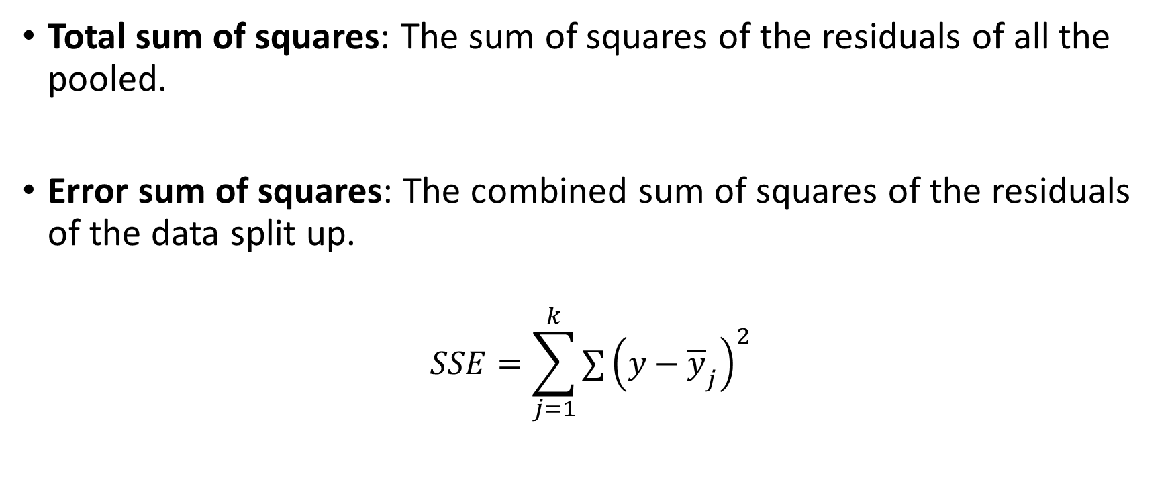
Error sum of squares (analyzing variances)
Total sum of squares: The sum of squares of the residuals of all the pooled.
Error sum of squares: The combined sum of squares of the residuals of the data split up.
$$SSE=\sum_{j=1}^{k}{∑}{\left(y−{\overline{y}}_{j}\right)}^{2}$$

Slide 33
Error sum of squares
sound <- senses_01[senses_01$Modality=="Sound",] taste <- senses_01[senses_01$Modality=="Taste",] residuals_Sound <- sound$Val - mean(sound$Val) residuals_Taste <- taste$Val - mean(taste$Val) error_sum_of_squares <- sum(residuals_Sound^2) + sum(residuals_Taste^2) error_sum_of_squares
## [1] 10.13909

Slide 34

Analysis of variance
total_sum_of_squares <- sum((senses_01$Val - mean(senses_01$Val))^2)
Total sum of squares
Error sum of squares
Treatment effect
$$SSE=\sum_{j=1}^{k}{∑}{\left(y−{\overline{y}}_{j}\right)}^{2}$$
sound <- senses_01[senses_01$Modality=="Sound",] taste <- senses_01[senses_01$Modality=="Taste",] residuals_Sound <- sound$Val - mean(sound$Val) residuals_Taste <- taste$Val - mean(taste$Val) error_sum_of_squares <- sum(residuals_Sound^2) + sum(residuals_Taste^2)
treatment_sum_of_squares <- total_sum_of_squares - error_sum_of_squares

Slide 35
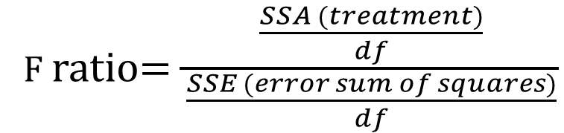
F table
 | Sum of squares | degrees of freedom | Mean square | F ratio
Sense | 4.48 | 1 | 4.48 | 49.78
Error | 10.13 | 114 – 2 | 0.09
Total | 14.62 | 113
F ratio$=\frac{\frac{SSA (treatment)}{df}}{\frac{SSE (error sum of squares)}{df}}$

Slide 36
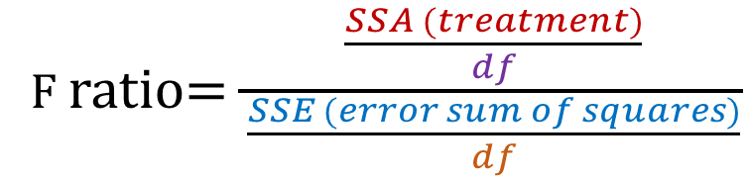
F table
Degrees of freedom are the maximum number of logically independent values, which may vary in a data sample. Degrees of freedom are calculated by subtracting one from the number of items within the data sample.
https://www.investopedia.com/terms/d/degrees-of-freedom.asp
 | Sum of squares | Degrees of freedom | Mean square | F ratio
Sense | 4.48 | 1 | 4.48 | 49.78
Error | 10.13 | n – 2 | 0.09
Total | 14.62 | n -1
F ratio$=\frac{\frac{SSA (treatment)}{df}}{\frac{SSE (error sum of squares)}{df}}$
F_ratio <- treatment_sum_of_squares / (error_sum_of_squares/112)

Slide 37
Analysis of variance
summary(aov(Val~Modality, data=senses_01))
## Df Sum Sq Mean Sq F value Pr(>F) ## Modality 1 4.485 4.485 49.54 1.65e-10 *** ## Residuals 112 10.139 0.091 ## --- ## Signif. codes: 0 '***' 0.001 '**' 0.01 '*' 0.05 '.' 0.1 ' ' 1

Slide 38
Quiz
Quiz: ceritus paribus ..
What happens to F if the error sum of squares increases?
What happens to F if the treatment increases?
What happens to F if the sample size increases?
What happens to F if there are more groups compared?

Slide 39
Exercise
Load the sharedref data from lingR (Ch. 8 Levshina)
Conduct and interpret an ANOVA that uses cohort as the predictor and mod as the dependent variable
Conduct and interpret an ANOVA that uses age as the predictor and mod as the dependent variable
Levshina, Natalia. 2018. How to do Linguistics with R: Data exploration and statistical analysis. John Benjamins Publishing.

Slide 40
Counts & contingency tables
A lot of statistical information comes from counts (e.g. frequency of words in different texts)
The data are usually presented in a contingency table.
Data from Matthew Dryer (1992)
OV = Object-Verb words order / VO = Verb-Object word order
Postp = positions / Prep = prepositions
H1:postpositions are associated with OV word order and prepositions are associated with VO order
Dryer, Matthew S. 1992. The Greenbergian Word Order Correlations. Languages 68:1, 81-138.

Slide 41
Contingency table (word order associations)
 | OV | VO
Postp | 107 | 12
Prep | 7 | 70
adpos <- matrix(c(107,12,7,70),ncol=2,byrow=TRUE) rownames(adpos)<-c("PostP","Prep") colnames(adpos)<-c("OV","VO") adpos
Dryer, Matthew S. 1992. The Greenbergian Word Order Correlations. Languages 68:1, 81-138.

Slide 42
Counts and probabilities
These are observed frequencies
We now need a model that predicts the expected frequencies
Using these data, what is the probability of a random language from this sample having OV?
Dryer, Matthew S. 1992. The Greenbergian Word Order Correlations. Languages 68:1, 81-138.

Slide 43
Counts and probability
wordorder <- cbind(c(107, 7), c(12, 70)) rownames(wordorder) <- c("Postp", "Prep") colnames(wordorder) <- c("OV", "VO") wordorder <- rbind(wordorder, c(114,82)) wordorder <- cbind(wordorder, c(119,77,196)) rownames(wordorder) <- c("PostP", "Prep", "Column Total") colnames(wordorder) <- c("OV", "VO", "Row total") wordorder

Slide 44
Expected Frequency
Raw total (Postp = 119, Prep = 77)
Column total (OV = 114, VO = 82)
Grand total = 196
Expected = (Raw total * Column total) / Grand total
Dryer, Matthew S. 1992. The Greenbergian Word Order Correlations. Languages 68:1, 81-138.

Slide 45
Expected frequency
The expected frequency refers to what the values would be if VO/OV and Postp/Prep were independent.
 | OV | VO
Postp | (114*119)/196 | (82*119)/196
Prep | (114*77)/196 | (82*77)/196
E <- cbind(c((114*119)/196, (114*77)/196), c(82*119/196,(82*77)/196)) rownames(E) <- c("Postp", "Prep") colnames(E) <- c("OV", "VO") E

Slide 46
Expected frequency
What we’ve done is created a hypothetical “null distribution” against which we can measure how surprising our actual data are.
 | OV | VO
Postp | 69.21429 | 49.78571
Prep | 44.78571 | 32.21429

Slide 47
Expected frequency vs. real frequencies
What we’ve done is created a hypothetical “null distribution” against which we can measure how surprising our actual data are.
 | OV | VO
Postp | 69.21429 | 49.78571
Prep | 44.78571 | 32.21429
 | OV | VO
Postp | 107 | 12
Prep | 7 | 70

Slide 48
Expected frequency vs. real frequencies
Its clear that the expected and the observed are different
But because of errors in sampling there is always some variation, so we are interested in whether the expected frequencies are significantly different
 | OV | VO
Postp | 69.21429 | 49.78571
Prep | 44.78571 | 32.21429
 | OV | VO
Postp | 107 | 12
Prep | 7 | 70

Slide 49
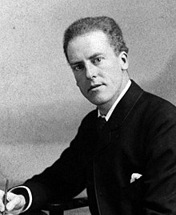
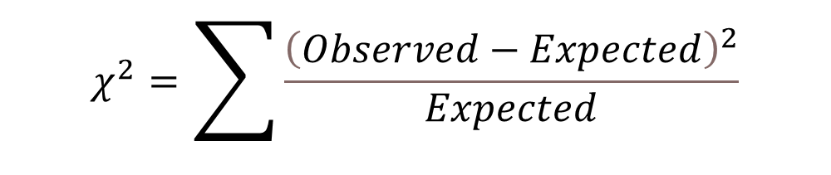
Chi-squared test
The classical way of doing this is Karl Pearson’s chi-squared test.
$$χ^{2}=\sum{\frac{{\left(Observed−Expected\right)}^{2}}{Expected}}$$
https://upload.wikimedia.org/wikipedia/commons/2/21/Karl_Pearson_2.jpg

Slide 50
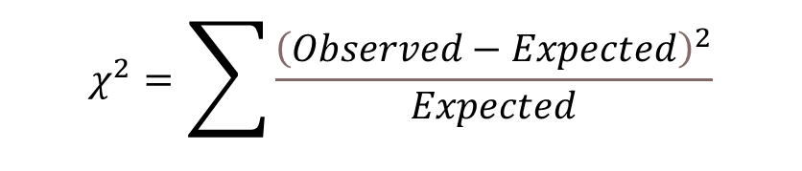
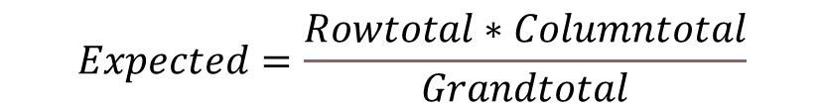
E <- cbind(c((114*119)/196, (114*77)/196), c(82*119/196,(82*77)/196)) rownames(E) <- c("Postp", "Prep") colnames(E) <- c("OV", "VO") E
$$Expected=\frac{Rowtotal∗Columntotal}{Grandtotal}$$
E.df <- melt(E)
colnames(E.df)<-c("Adposition", "Verb.Object", "Expected.Frequency") E.df$Observed.Frequency <- c(107,7,12,70) E.df
Putting expected and observed data in the same data set
E.df$oe <- ((E.df$Observed.Frequency - E.df$Expected.Frequency)^2) / E.df$Expected.Frequency sum(E.df$oe)
$$χ^{2}=\sum{\frac{{\left(Observed−Expected\right)}^{2}}{Expected}}$$

Slide 51
Chi-squared test and p values
Is this number big?
What is the critical value of the chi-squared test?
To calculate this, we need the degrees of freedom and the cut off area you want.
R = number of rows
C = number of columns

Slide 52
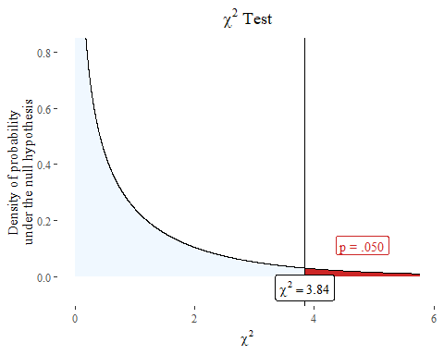
Chi-squared test and p-value
We have another hypothetical distribution based like the t distribution.

